Slide 1
Geology: Application of Matrices
Name: Chahel Gupta
Roll No.: C049
Batch: B2

Slide 2
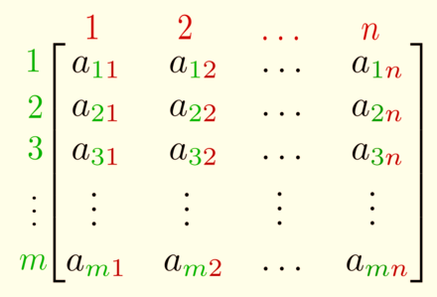
What is a Matrix?
A matrix is a set of numbers arranged in rows and columns.
We refer to the size of a matrix by giving its number of rows and number of columns, in that order.
So the given matrix has ‘n’ rows and ‘m’ columns – we say it is a ‘n by m’ matrix and write it as ‘n x m’.

Slide 3
Applications of Matrices in Geology
In geology, certain types of matrices are used for making seismic surveys and using those surveys matrices are also implemented in making seismic wave images.
Matrices are used in representing the real world data’s like the population of people, infant mortality rate, etc.
They are also used for plotting graphs, statistics and also to do scientific studies and research in almost all different fields.

Slide 4
What is Seismology?
Seismology is the study of earthquakes and seismic waves that move through and around the Earth.
What are
Seismic Waves?
Seismic waves are caused by the sudden movement of materials within the Earth, such as slip along a fault during an earthquake.

Slide 5
Data Matrix
It is the tabular format representation of cases and variables of the required statistical study.
Each row of a data matrix represents a case and each column represent a variable.
Variables
Data Matrix | Region 1 | Region 2 | Region 3
Characteristic 1
Characteristic 2
Characteristic 3
Cases

Slide 6
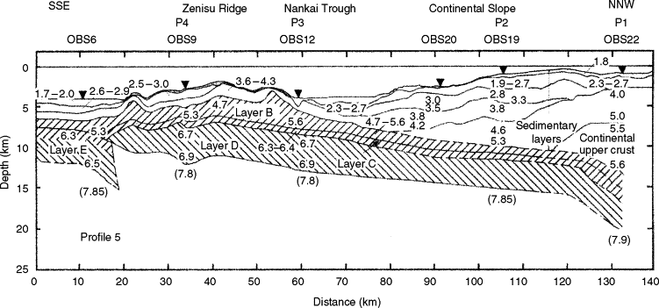
What is a Seismic Survey?
A seismic survey is a low impact, non-invasive method of gathering information about the location and characteristics of geological structures beneath the Earth’s surface. This information is used to produce maps of structures identifying areas where gas deposits may be found.

Slide 7
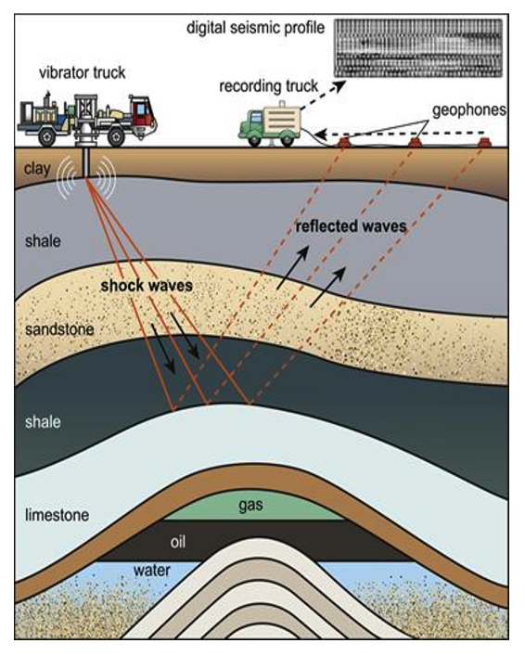
How is the survey done?
The seismic survey is carried out by a specially configured truck (called a vibroseis truck) that lowers a plate onto the surface.
This plate generates an acoustic sound signal that is transmitted into the earth’s surface which then reflects off the various geological layers.
The returning sounds waves are recorded by small microphones (geophones) strung together that are laid along a predetermined and prepared path called a seismic line.

Slide 8
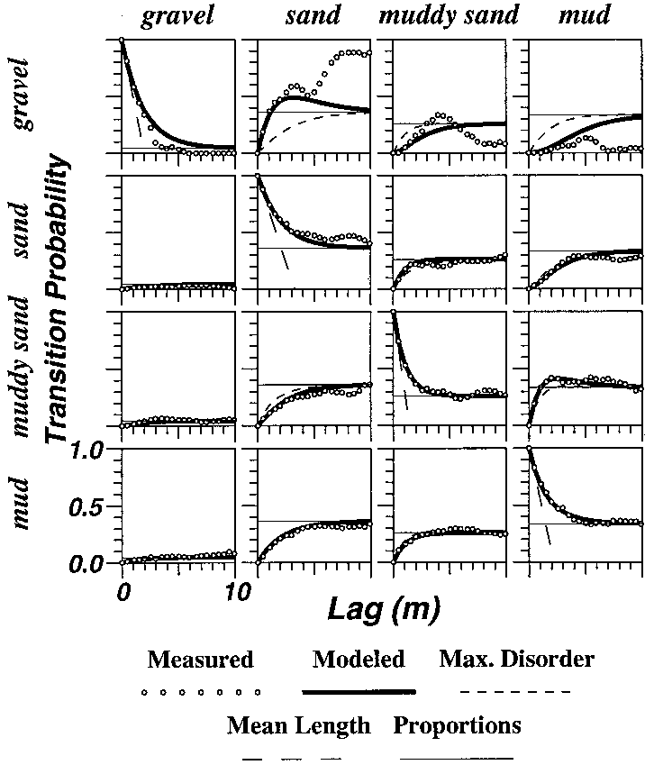
Seismic data records can be conveniently arranged in a data matrix.
The data matrix contains signals that can be expressed in terms of wavefield operators describing propagation and reflection in the subsurface.
The digital image formed by the collected data is called a digital seismic profile(image).

Slide 9
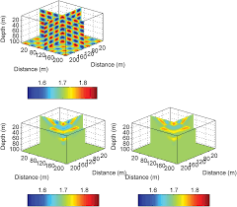
Seismic Imaging using Matrices
A set of matrix operations can be applied for imaging purposes at each layer of the earth’s crust.
First, the reflection matrix is projected, which later yields a response matrix associated with an array of virtual geophones located at the ballistic depth.
When stacked, the results obtained at each depth give a three-dimensional image of the required layer.

Slide 10
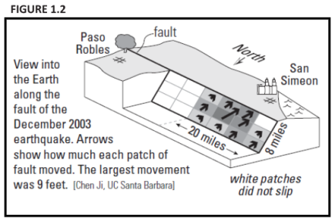
Example of Seismic Imaging using Matrices:

Slide 11
References
https://www.youtube.com/watch?v=J-kSaaOfVww
http://makemeanalyst.com/explore-your-data-matrix-and-frequency-table/
https://link.springer.com/chapter/10.1007/978-0-387-30441-0_86
https://www.encyclopedia.com/science/dictionaries-thesauruses-pictures-and-press-releases/seismic-record
https://help.turnitin.com/revision-assistant/prompts-resources/prompts-secondary-ed/grades-6-12/seismic-technology.htm
https://www.tandfonline.com/doi/abs/10.5408/0022-1368-40.5.356?journalCode=ujge19
https://mxrap.com/moment-tensors-a-practical-guide/
https://agupubs.onlinelibrary.wiley.com/doi/full/10.1029/2018JB016361
https://ui.adsabs.harvard.edu/abs/2017AGUFM.S31A0781B/abstract
https://www.ncbi.nlm.nih.gov/pmc/articles/PMC5795022/
https://www.researchgate.net/figure/Matrix-of-vertical-direction-transition-probabilities-showing-US-Geological-Survey-core_fig2_228878161
https://www.researchgate.net/publication/228878161_Three-dimensional_hydrofacies_modeling_based_on_soil_surveys_and_transition_probability_Geostatistics#pf4
http://www.unige.ch/ses/sococ/cl//stat/concepts/datamatrix.html
https://repository.tudelft.nl/islandora/object/uuid%3A85b14457-8770-463a-af0c-ff2243ac1b01/datastream/OBJ/download.
https://www.mtu.edu/geo/community/seismology/learn/seismology-study/

Slide 12
Thank You!

